Slide 1
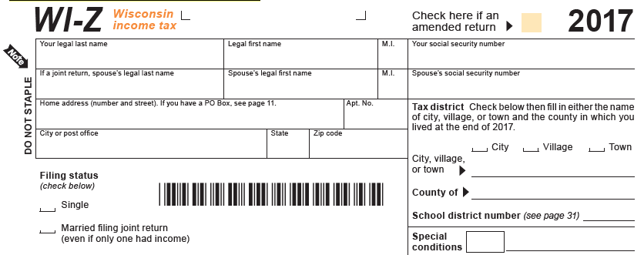
State Income Tax
Exactly as shown on your Form W2
Leave Blank For Now! Remember to fill in before sending.
Check one here Most likely, Village.
Deerfield?
Dane
1309
Current Address, not one listed on W2 if it has changed.
Check here

Slide 2
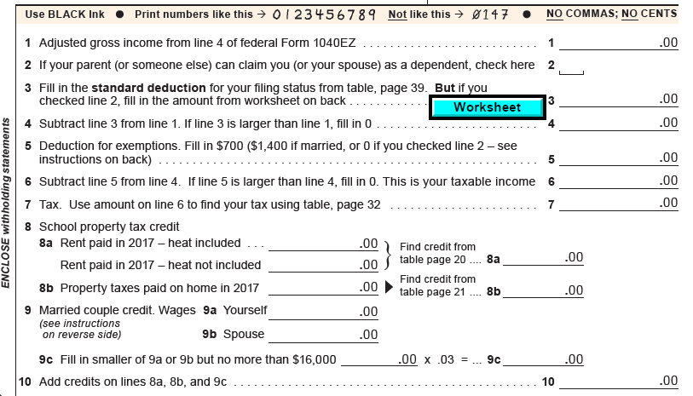
Amount on Line 4 of your Federal 1040 EZ.
Check here if someone claims you as a dependent.
If so, use the Worksheet to figure amount for Line 3
Line 1 – Line 3
If Line 3 > Line 1 enter Zero
If you checked Line 2, fill in zero here.
Line 4 – Line 5 = Line 6
If Line 5 > Line 4 enter zero
If Line 6 < $20, fill in zero on Line 7. If not, ask for help.
Fill in this section if: You payed rent, own a home, or are married. If none of these apply, leave this section blank and fill in zero on Line 10

Slide 3
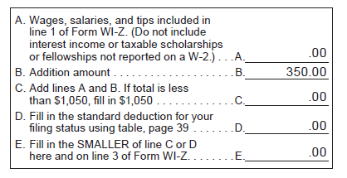
Standard Deduction Worksheet
(Used to figure out Line 3 of your WI-Z)
Enter the amount from Line 1 above minus any interest income included in Line 1.
A + B = C
If C < $1050, Fill in $1050
Enter $10380 if Line 1 of your WI-Z above is less than $15000.
Enter the smaller of Lines C & D here and on Line 3 of your WI-Z above
Click here to skip to next slide

Slide 4
Line 7 – Line 10 = Line 11
If Line 10 > Line 7, fill in zero on Line 11
Sales taxes that you did not pay due to internet or out of state purchases.
If you made none, check this box.
Fill in this section if you wish to donate to any of these causes.
Donating reduces your refund or increases your tax due.
Line 11 + Line 12 + Line 13i = Line 14

Slide 5
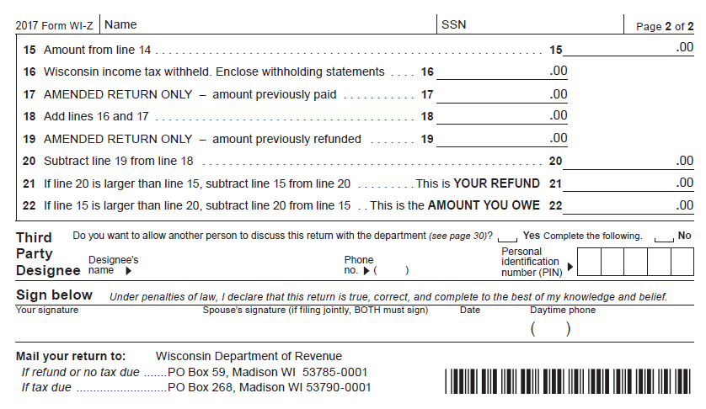
Leave Blank For Now! Remember to fill in before sending.
Exactly as shown on your forms W2
From Line 14 above
From Box 17 of all forms W2
Line 16 + Line 17 = Line 18
Line 18 - Line 19 = Line 20
If Line 20 > Line 15:
Then Line 20 – Line 15 = Line 21.
If Line 15 > Line 20:
Then Line 15 – Line 20 = Line 22.
Sign your name in your very best cursive

Slide 6
Reminders…
1. Make sure to fill in your social security number on pages 1 & 2 prior to sending in your return.
2. You must send a complete and signed Federal 1040EZ form with your Wisconsin State WI-Z.
3. Make sure to send the correct copy of each of your forms W2 with your return.
4. Make a copy of your WI-Z form for your records.
5. See mailing instructions on the bottom of page 2 of your Wisconsin WI-Z form.
5. If you choose to E-File your return, use this link: Wisconsin E-file.

